Slide 1
High-Dosage Tutoring:
A Statewide Literacy Strategy
Legislative Briefing — March 27, 2025

Slide 2
MBAE and the employers we represent believe that an excellent public education system is the essential foundation of a sound and equitable economy.
We promote and support continuous improvement in our schools to ensure that EVERY student receives a high-quality education that prepares them for success in college, career, and citizenship.

Slide 3
Literacy Crisis in Massachusetts

Slide 4
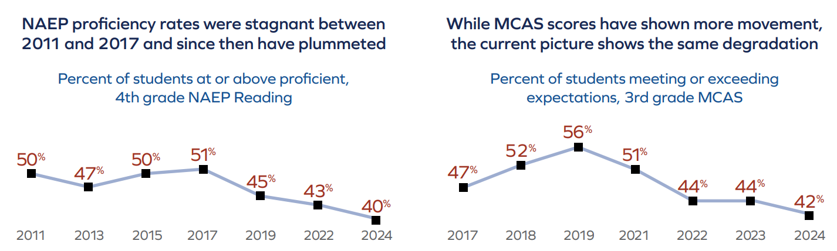
In Massachusetts, we have struggled to make major gains in literacy and now see students at lower levels of proficiency than 10 years ago.

Slide 5
We need innovative, evidence-based solutions to combat these challenges.
High-quality, high-dosage tutoring models like the subject of today’s briefing are accelerating student recovery.

Slide 6

MBAE Policy Analysis and Recommendations
Main recommendation: MA should create a statewide first-grade literacy safety net for students in schools that are using evidence-based curriculum and that have high concentrations of low-income students.
Annual cost = $25 million

Slide 7
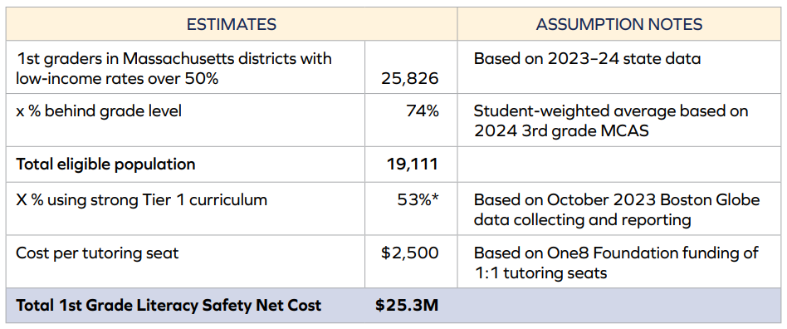
1st Grade Literacy Safety Net— Annual Cost Breakdown

Slide 8
Potential Impact on Student Achievement
In theory, over time, schools with:
Strong Tier 1 Instruction + High-Dosage Tutoring = reading proficiency rates of 80% for their 2nd graders
Compared to today when 3rd grade MCAS results show just 42% of students are proficient in third grade

Slide 9
FY26 Budget
Governor Healey’s proposed FY26 supplemental budget (H.55) includes $25 million for high-dosage early literacy tutoring (line item 1596-2515)
This funding would support HDT for 10,000 students in grades K-3
Priority would be given to first grade students who are scoring below their reading benchmark scores

Slide 10
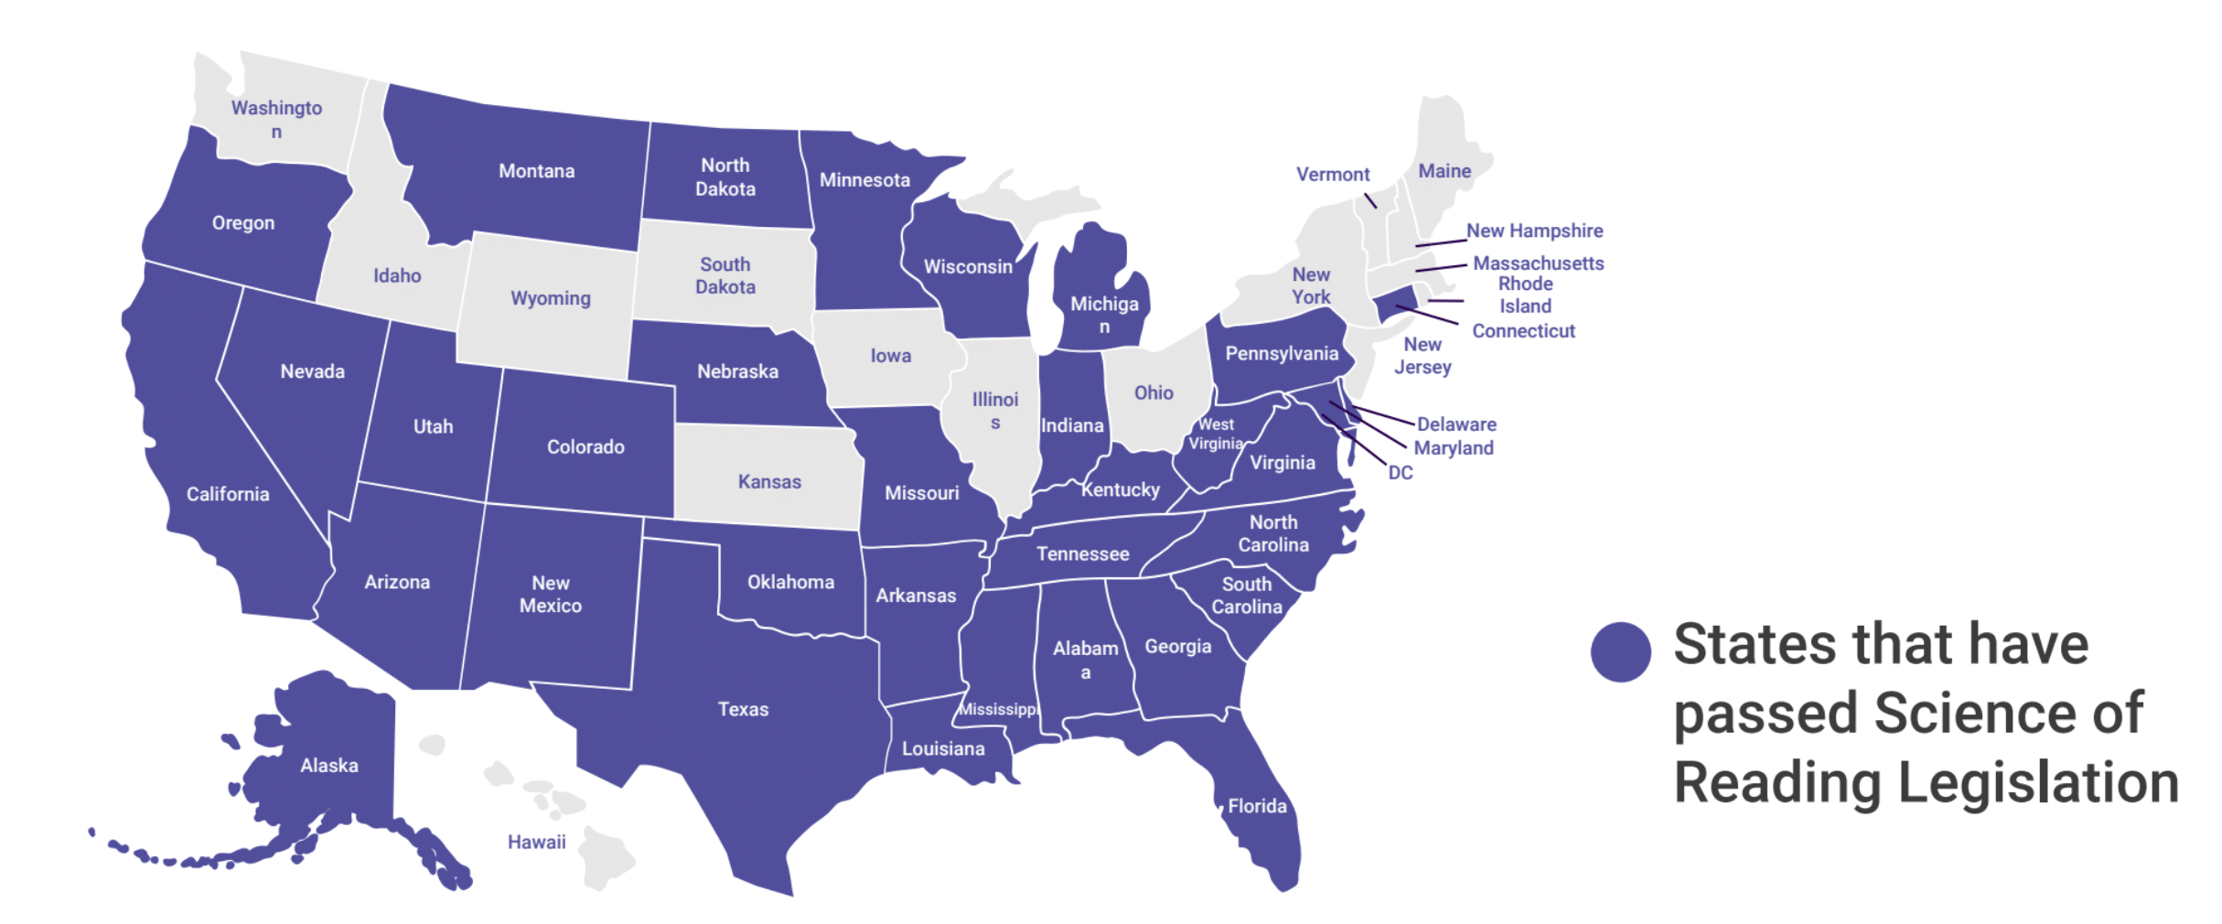
MA is one of 16 states without Science of Reading Legislation
Only around half of MA districts embrace a “Science of Reading” approach that prioritizes explicit, code-based instruction

Slide 11
2025-26 Legislative Session—Science of Reading
S.338 (Sen. DeDomenico) / H.698 (Rep. Sena)— An Act promoting high-quality comprehensive literacy instruction in all Massachusetts schools
Requires districts to use literacy curricula that are aligned with evidence-based literacy instruction.
Requires DESE to provide tools and resources that would aid districts in providing adequate professional development aligned with evidence-based literacy instruction for teachers, paraprofessionals, and reading specialists.
Requires DESE to create a list of professional development programs and vendors aligned with evidence-based literacy instruction best practices, as well as a set of online training modules.

Slide 12
High-Dosage Tutoring:
A Statewide Literacy Strategy
Legislative Briefing — March 27, 2025

Slide 13


Ensuring every student becomes a confident, fluent reader
by the end of 1st grade

Slide 14
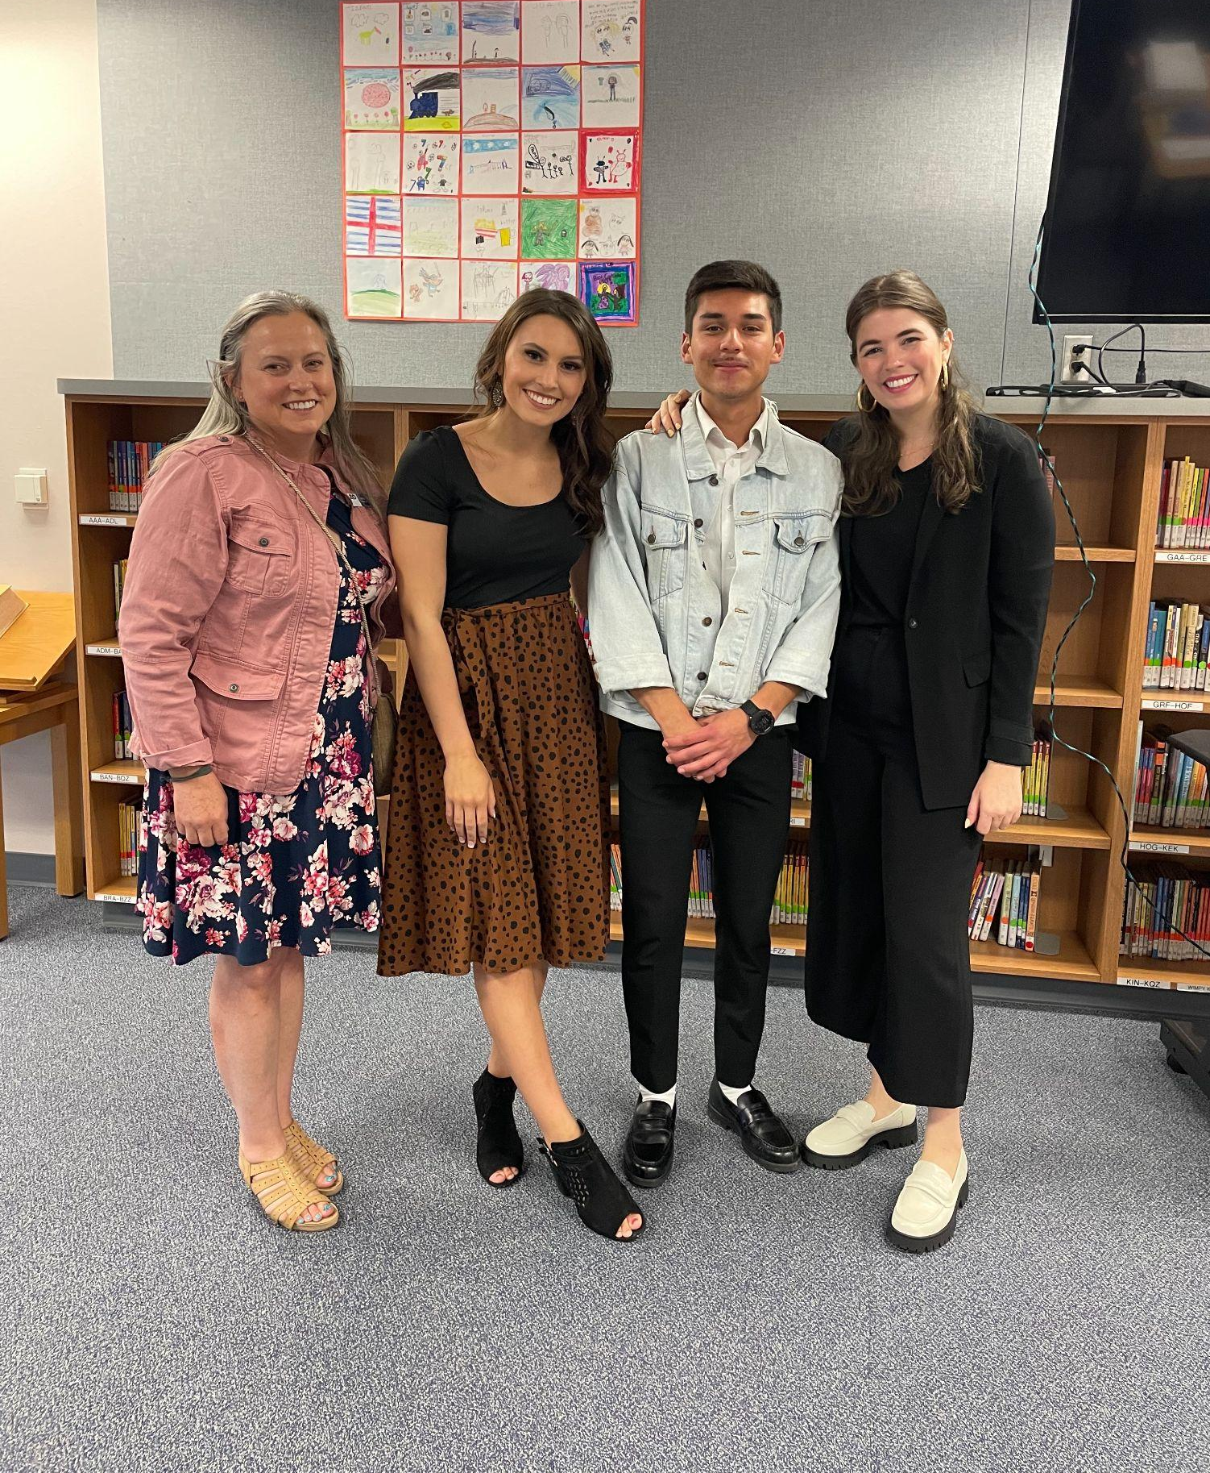

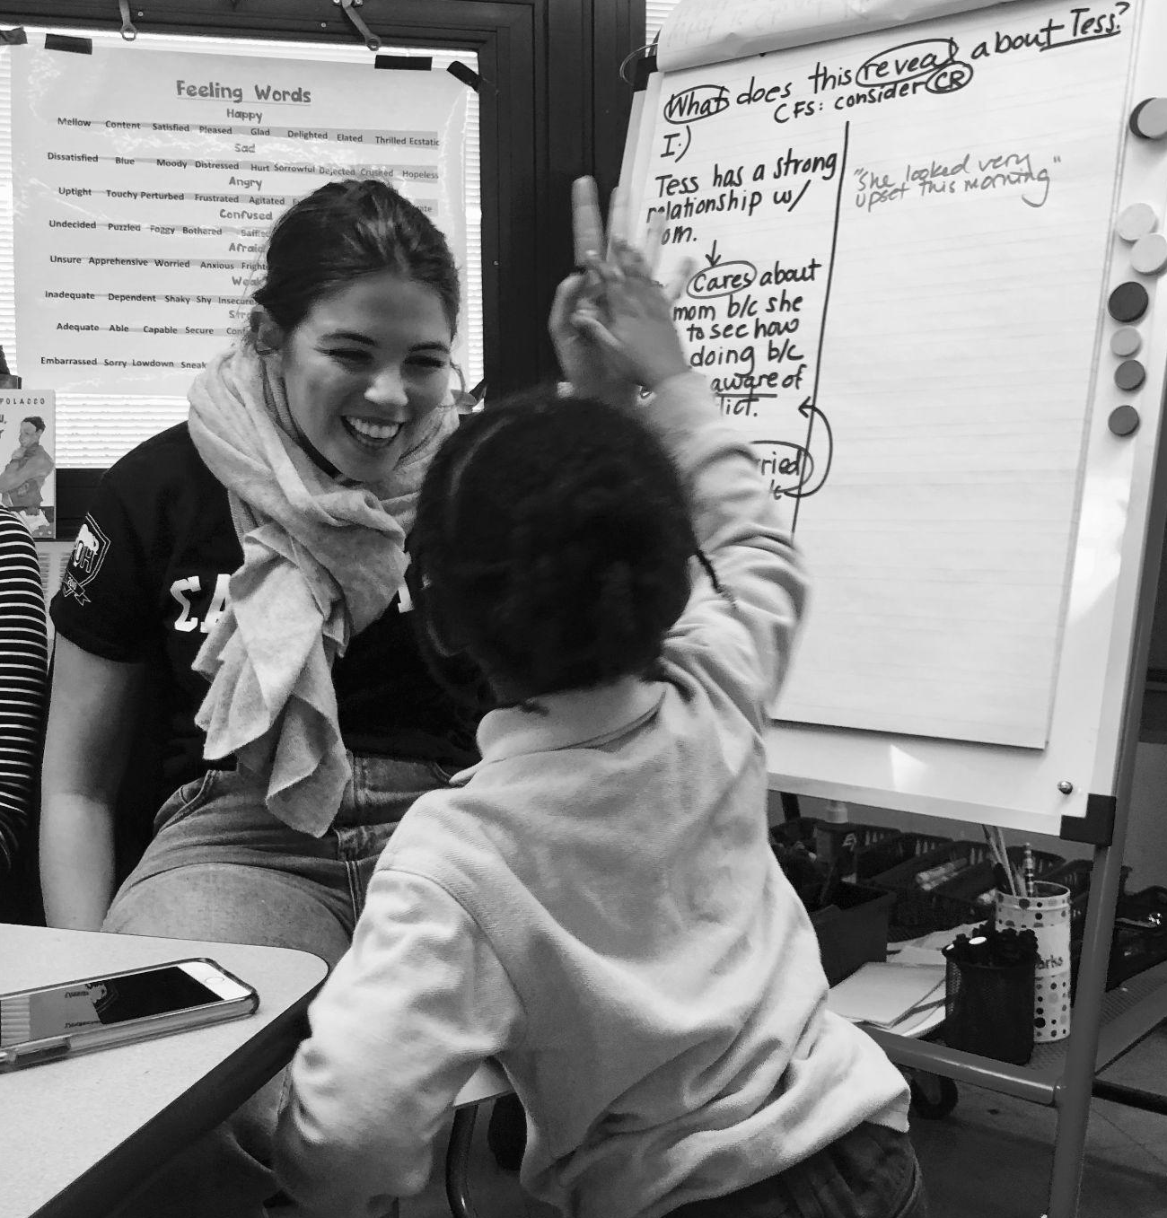
Charlotte Marks
Vice President of Academics and
Founding Team Member of Ignite Reading

Slide 15

Scarborough’s Reading Rope
Ignite Reading focuses on the lower strands: Foundational Reading Skills
LANGUAGE COMPREHENSION
THE MANY STRANDS THAT ARE WOVEN INTO SKILLED READING
Background Knowledge
INFINITE
Vocabulary
Language Structures
increasingly strategic
SKILLED READING
Verbal Reasoning
Literacy Knowledge
WORD RECOGNITION
FINITE
Phonological Awareness
Decoding
increasingly automatic
Sight Recognition
Scarborough, H. S. (2001). Connecting early language and literacy to later reading (dis)abilities: Evidence, theory, and practice.
Notes:
The science of reading breaks down what it takes become a skilled reader. The top set of skills represents how we understand texts and the bottom set of skills is how we read text. As fluent skilled adult readers we dont often think about what it takes to read a word, a sentence, or paragraph, or the pre-reading you were sent before this session… but none of that is innate, in fact it must be explicitly taught.

Slide 16
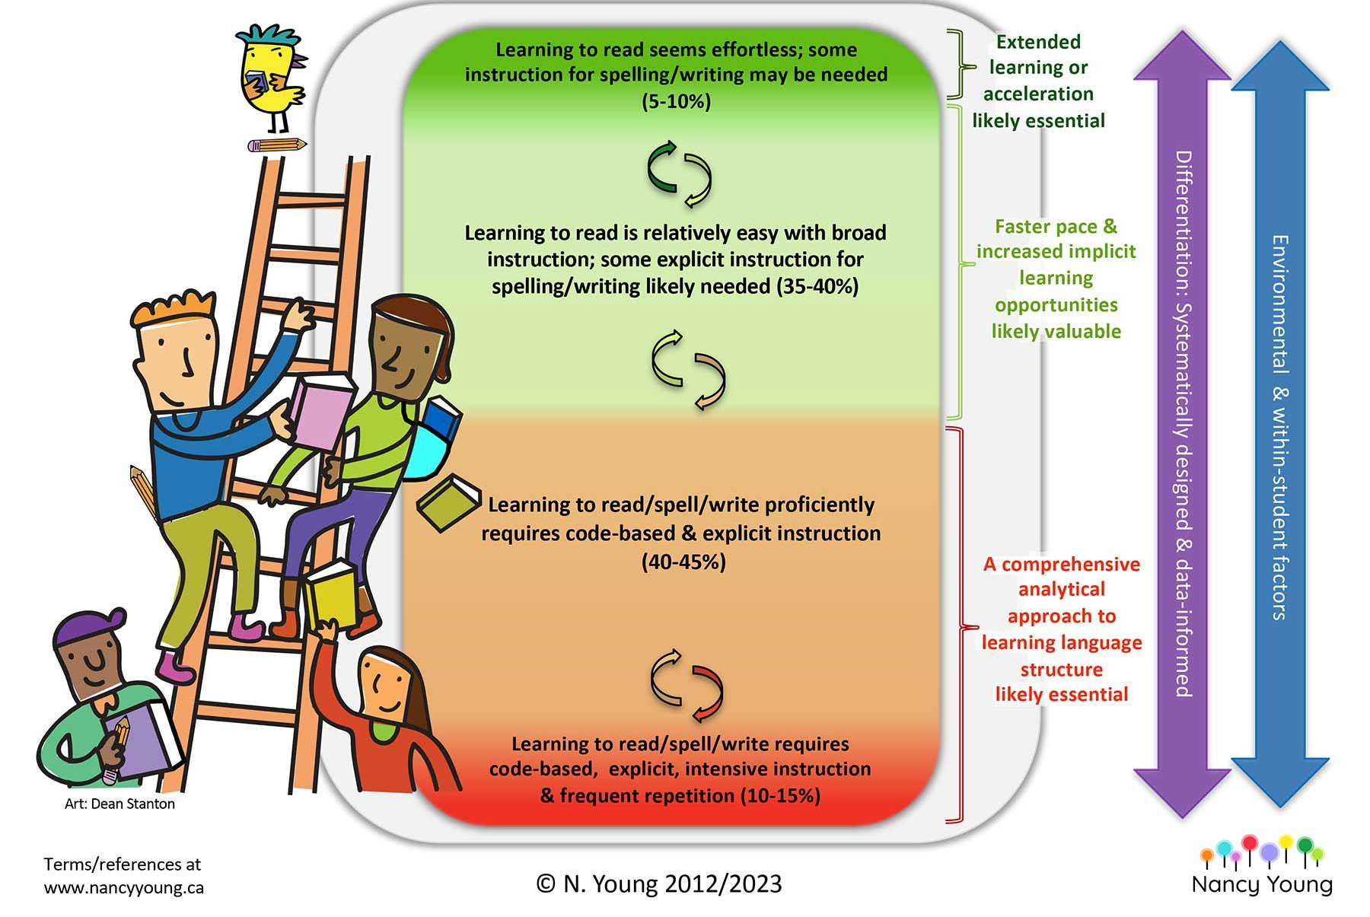
What Nancy Young’s
Ladder of Reading Tells Us
~50-60% of students require a Structured Literacy approach to reading instruction, with the opportunity for extensive practice, in order to develop into fluent readers
Notes:
Nancy Young’s research reflected in her Ladder of Reading helps us understand what it takes for each student to acquire those essential skills to learn how to read. Her research shares that all students can develop into fluent readers and that different brains need different things in order to develop these skills. While for some kids it is easy, for 50- 60% they must be taught how to read using code-based explicit instruction with frequent repetition. This research tells us that there is a pathway to a state and country where all students become fluent readers as long as we are giving students the instruction and practice they need to do so.

Slide 17
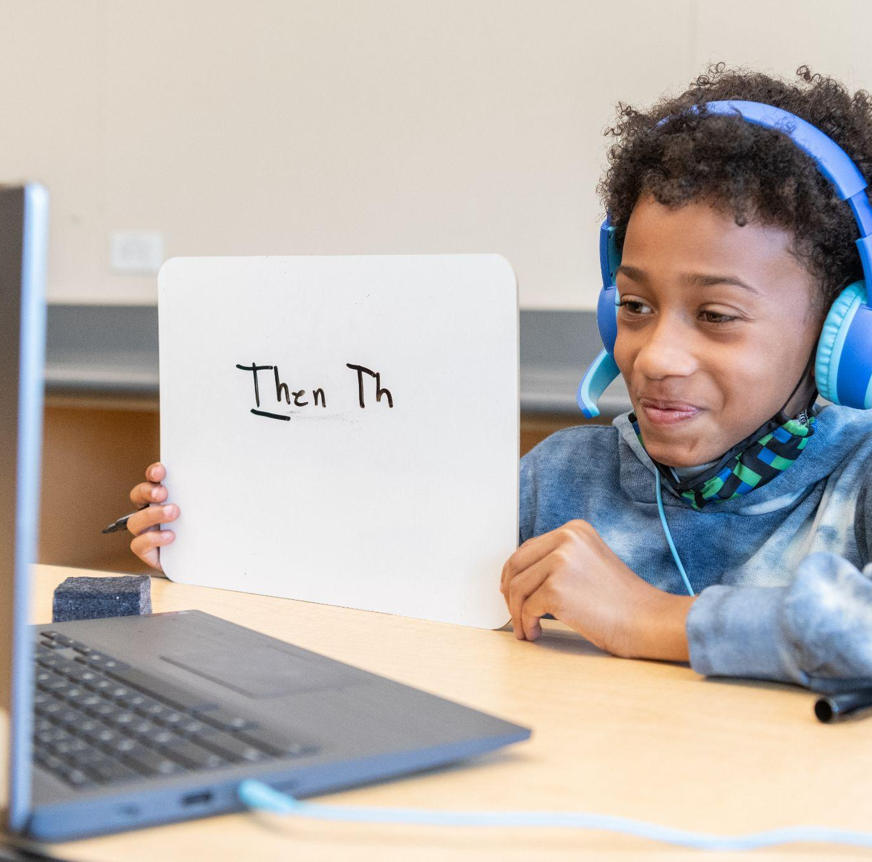

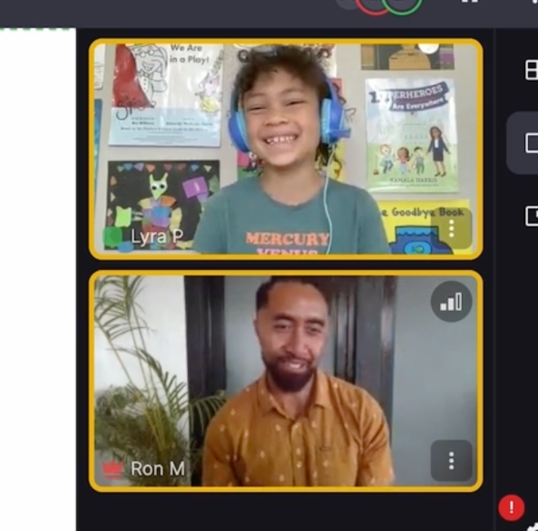
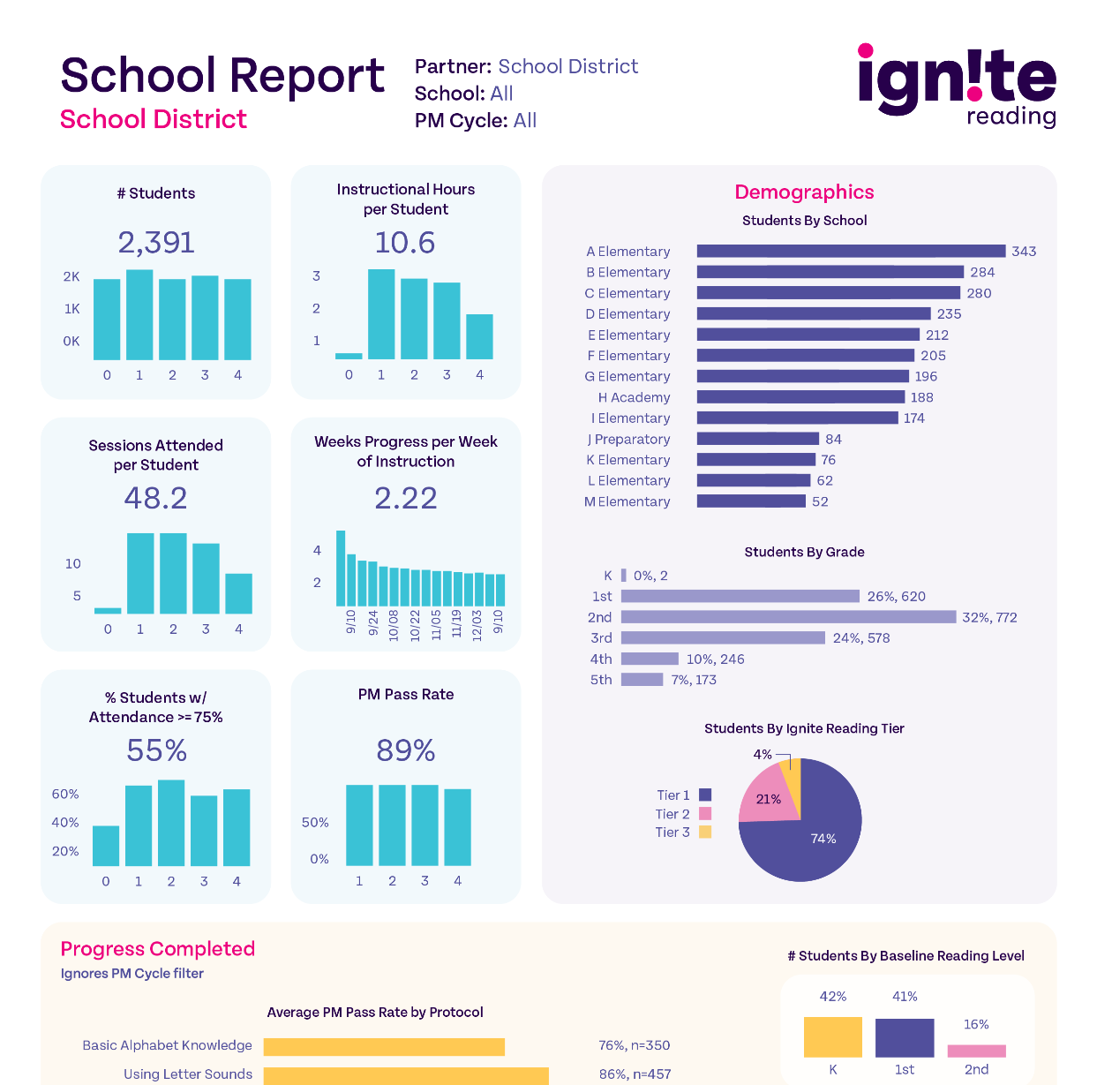
How We Do It
High-Impact
Program Model
High Quality Instructional Materials
Daily, during school, consistent tutor
Science of Reading-based
Highly-trained Reading Instructors
Dedicated Literacy Specialist
100+ hours of professional learning
Integrate Insights, Drive student outcomes
Notes:
So how do we get kids exactly what they need to become a fluent reader? High-dosage tutoring.
With a high impact model of 15 min a day, every single day, with the same highly trained tutor for the whole year, you have the unique opportunity to be responsive to students needs on their learning journey on a individualized basis.
Effective high-dosage tutor ensures that you implement the high impact model with high quality instructional materials grounded in research, highly developed reading instructors, and a partnership that allows the schools to leverage the understandings we gain from our 1 to 1 learning model, to strengthen the way they are serving students in their school buildings.
High dosage tutoring is an essential partner to schools who are working hard to make sure every student who walks through their doors becomes a reader because it allows them to hold true on their promise of meeting all students needs.

Slide 18

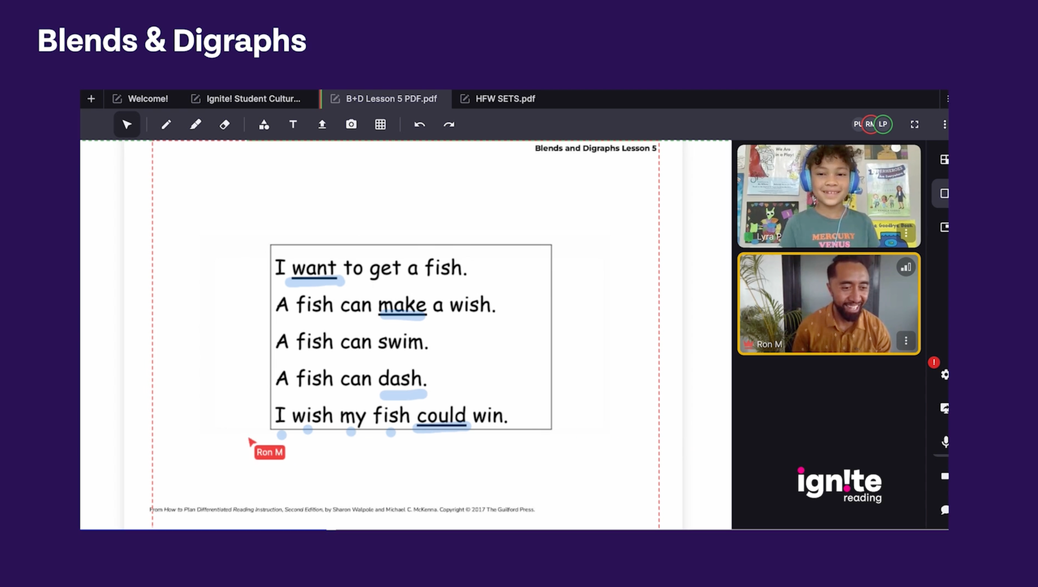
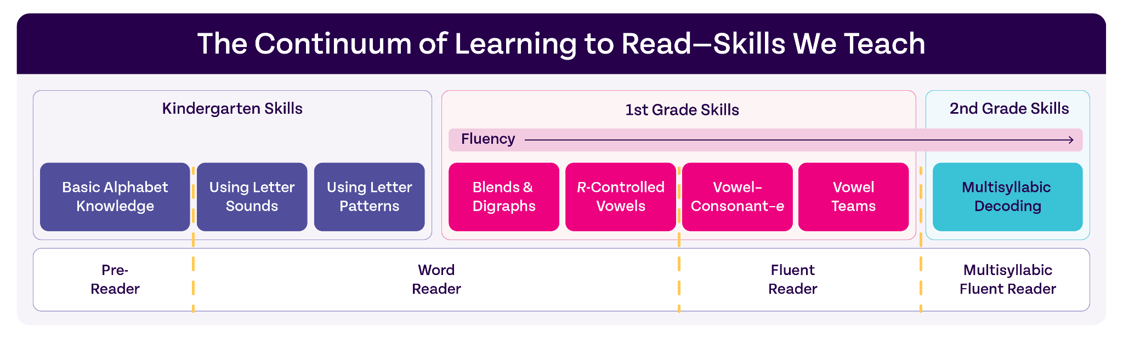
Meet Ron & Lyra
Blends & Digraphs Lesson
Notes:
We are about to dive into some video.
We have broken what it takes to become a skilled reader into a continuum of discrete skills which allows us to meet students exactly where they are. One of the discrete skills is reading words with digraphs. We have to explicitly teach students that sometimes in English two letters with their own unique sounds work together to make a different sound, because english is intricate and nuanced! In this video you will see Lyra learning about the digraph sh and be able to see her tutor Ron explicitly teach her this part of the code and then practice it in context throughout their tutor session.
This many words in this many minutes
Some of them have the skills she is working on, some are skills she has mastered

Slide 19

Thank You
www.ignite-reading.com
Notes:
Thank you for the time, Im excited for you to learn even more about the impact of this innovative initiative from Amanda and with that I will pass it back to Ed.

Slide 20
High-Dosage Tutoring:
A Statewide Literacy Strategy
Legislative Briefing — March 27, 2025

Slide 21
An Evaluation of Ignite Reading in Massachusetts
March 26, 2025
Amanda Neitzel, PhD

Slide 22
Study Overview
Goals:
Evaluate the impact of Ignite Reading on early literacy outcomes.
Gather stakeholder perceptions on program value and integration.
Research Design:
Mixed-methods approach
Quasi-experimental framework

Slide 23
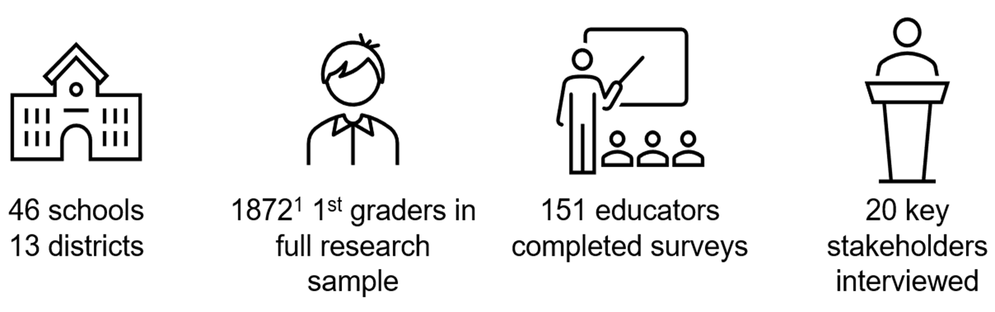
Participants

Slide 24
High Dosage Tutoring Model Studied
Ignite Reading
Programmatic Support
Virtual “1 to 1” instruction
Daily, 15-minute tutoring sessions conducted in school
Students have the same tutor throughout the program
evidence-based literacy curriculum
Progress monitoring every 14 weeks
Monthly data meetings with school/district leaders to review progress
Program manager working closely with districts/schools and HDT provider to
collect and monitor data,
craft policy,
troubleshoot implementation issues
Eligibility requirements for districts
District champions and stipended school champion roles
In-person and virtual cohort convenings – to ensure milestone alignment and share best practices

Slide 25
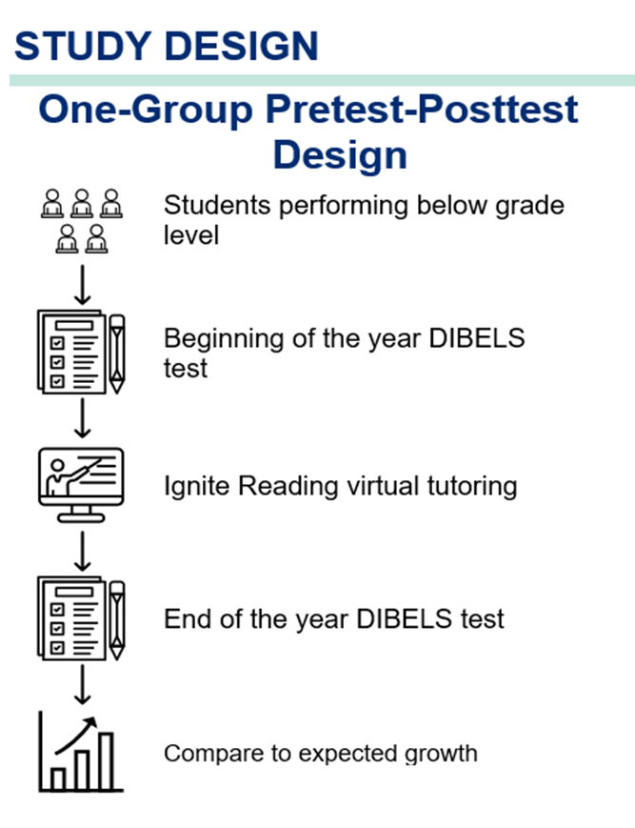
Key Quantitative Findings: One-Group Pre-Post Analysis

Slide 26
Key Quantitative Findings: One-Group Pre-Post Analysis
29% of students
moved from Intensive to Benchmark:
*Overall Attendance Rate: 89%

Slide 27
Key Quantitative Findings: One-Group Pre-Post Analysis
*Students Across Demographics Gained Over Five Additional Months of Learning

Slide 28
Key Quantitative Findings: One-Group Pre-Post Analysis
*Students With the Highest Attendance Gained The Most

Slide 29
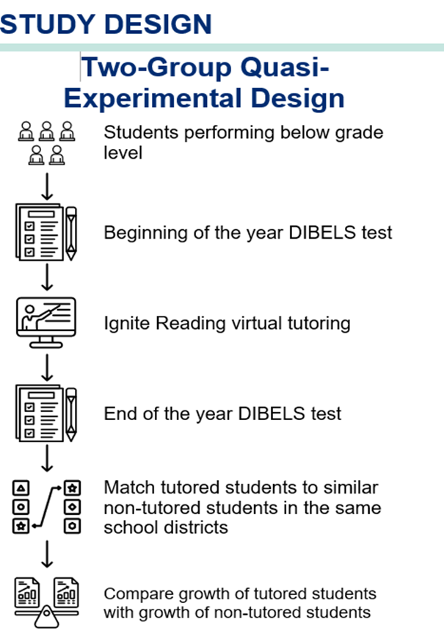
Key Quantitative Findings: Two-Group Comparison Analysis

Slide 30
Key Quantitative Findings: Two-Group Comparison Analysis
Group | Effect Size
Overall | +0.21 SD
African American Students | +0.24 SD
Hispanic Students | +0.14 SD
Other Students | +0.32 SD
White Students | +0.18 SD
English Learners | +0.31 SD
*Students Across Demographics Closed Skills Gaps At Meaningful Rates

Slide 31
Key Qualitative Findings
Overall Impressions from Participants
Supporting Conditions to Enhance Success
The Substantial Instructional Value of One-to-One Tutoring
Perceived Impacts on Early Literacy Skills
Integration with Multi-Tiered Systems of Support
Navigating Teacher Buy-in, Communication, Logistics, and Other Conditions to Support Success
Building teacher and school buy-in early
“School Champions” and planning
Leveraging school and teacher expertise in…
Integrating tutoring as part of existing MTSS/RTI frameworks
Strategizing tutoring delivery and implementation
Navigating technology use with young students
Leveraging Ignite Reading resources and support

Slide 32
Key Quantitative Findings: Two-Group Comparison Analysis
*Results Compare Favorably to Other Interventions

Slide 33
High-Dosage Tutoring:
A Statewide Literacy Strategy
Legislative Briefing — March 27, 2025

